Slide 1
UNIT-I:
Introduction: Features and advantages of Node JS, Traditional Web Server Model, Node.js Process Model, Asynchronous programming with Node.js, Types of applications that can be developed using Node.js.
Setup Development Environment: Install Node.js on Windows, working in REPL, Node JS Console, Creating a Node File with JavaScript, Accessing a Node.js File Through the Command Line Interface, Using Node.js in Net- Beans IDE.

Slide 2
What is Node.js :
Node.js is an open-source, cross-platform JavaScript runtime environment that executes JavaScript code outside of a web browser primarily on the server side. It uses the V8 JavaScript engine from Google to compile JavaScript code into native machine code, allowing it to run at near-native speeds.
What is .js (JavaScript):
JavaScript is a lightweight, interpreted, or just-in-time compiled programming language primarily used to create interactive and dynamic features on websites. It is one of the core technologies of the web, alongside HTML and CSS. JavaScript is versatile and can be used for both client-side and server-side development.

Slide 3
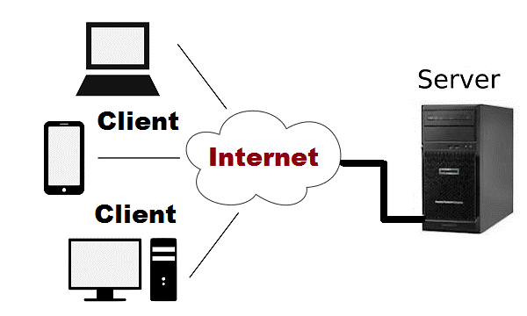
History and Evolution of Node.js:
Node.js was created by Ryan Dahl in 2009. It was inspired by the limitations of traditional web servers, which were not well-suited for handling large number of concurrent connections. Node.js was designed to be lightweight and efficient, making it ideal for building scalable network applications.

Slide 4
Traditional Web Servers:
In the traditional web server model, each client request is handled by a separate thread or process. This can lead to scalability issues when handling large number of concurrent connections, as each thread or process consumes system resources.
The traditional web server model can be inefficient and resource-intensive, especially for I/O bound applications that spend a significant amount of time waiting for I/O operations to complete. This can lead to poor performance and scalability issues.

Slide 5
Limitations of Traditional Web Servers:
1. Thread-Based Handling:
Model: Traditional servers spawn a new thread or process for each incoming connection.
Limitations:
High memory consumption as each thread/process requires a dedicated memory space.
Increased CPU overhead when managing thousands of threads.
Poor scalability when handling a large number of concurrent connections.
2. Blocking I/O Operations:
Nature: Many traditional servers use a blocking I/O model, where a thread waits for disk or network operations to complete.
Impact:
Wastes server resources by keeping threads idle.
Reduces overall throughput for applications requiring high concurrency.
Slower response times for I/O-heavy workloads.

Slide 6
3. Resource-Intensive:
Traditional web servers tend to consume significant memory and CPU resources due to their multi-threaded or multi-process model.
These servers struggle with modern web use cases like real-time data streaming and APIs with high traffic.
4. Latency in Handling Requests:
Due to synchronous execution, servers can face delays:
A time-consuming request can block subsequent ones.
Requests are often queued while waiting for resources to become available.
5. Lack of Real-Time Capability:
Traditional web servers were not optimized for real-time, bidirectional communication:
WebSockets and real-time streaming (e.g., chat apps, live updates) are difficult to implement.

Slide 7
6. Complexity in Handling Asynchronous Tasks:
Traditional web servers are primarily designed for synchronous request-response models.
Managing multiple I/O tasks asynchronously often requires additional libraries or workarounds.
7. High Overhead for Small Requests:
For lightweight or frequent requests (e.g., APIs or microservices), creating and managing threads introduces overhead.
This makes the server inefficient for use cases requiring high-frequency, low-latency responses.

Slide 8
Before Node.js:
Technology | Language | Key Usage | Limitations
Apache | C/C++ | Web server | Blocking I/O, memory-heavy
PHP + Apache | PHP | Dynamic websites | Synchronous execution
Java Servlets/JSP | Java | Enterprise applications | Resource-intensive concurrency
ASP.NET | C#, VB.NET | Web services (Windows) | Costly scalability
Ruby on Rails | Ruby | Web applications | Performance limitations
Python (Django) | Python | Web APIs, CMS | Blocking I/O
Perl | Perl | Early dynamic content | Poor scalability
C/C++ Servers | C/C++ | Custom high-performance | Development complexity

Slide 9
Features and Advantages of Node.js:
Feature | Advantage over the Feature
Event-Driven Non-Blocking I/O | Efficient handling of concurrent requests.
Single-Threaded Event Loop | Lightweight and fast execution.
NPM Package Manager | Faster development with reusable modules.
Built on V8 Engine | High performance and speed.
Cross-Platform Support | Runs on Windows, Linux, and macOS.
Full-Stack JavaScript | Unified language for frontend and backend.
Scalability | Handles high traffic with minimal resources.
Real-Time Capability | Ideal for chats, games, and live updates.

Slide 10
Features of Node.js:
Event-Driven and Non-Blocking I/O Model:
Node.js uses an asynchronous, event-driven architecture.
The non-blocking I/O allows handling multiple operations (like file reads, network requests) simultaneously without waiting for each to complete.
This improves efficiency for I/O-bound applications.
Single-Threaded with Event Loop:
Node.js operates on a single-threaded event loop that efficiently manages multiple concurrent connections.
This eliminates the overhead of creating threads for every request, as seen in traditional servers.
Built on V8 JavaScript Engine:
Node.js is powered by Google’s V8 JavaScript engine, which compiles JavaScript code into machine code for faster execution.
It makes Node.js lightweight and extremely fast.

Slide 11
4. NPM (Node Package Manager):
Node.js comes with NPM, the world’s largest package ecosystem, with thousands of open-source libraries and tools.
Developers can easily install, share, and manage project dependencies.
5. Cross-Platform:
Node.js runs seamlessly on all major platforms, including Windows, Linux, and macOS.
It also supports containerization tools like Docker.
6. Real-Time Data Streaming:
Node.js excels at handling real-time, bidirectional communication between server and client.
It is widely used for applications like chats, gaming, and live updates.

Slide 12
7. Scalable and Lightweight:
The non-blocking event loop allows Node.js to efficiently handle a high volume of concurrent requests without consuming large amounts of memory.
8. Microservices Architecture Support:
Node.js is ideal for building microservices due to its modular and lightweight nature.
Applications can be split into smaller, manageable services.
9. Full-Stack JavaScript:
With Node.js, JavaScript can be used on both the frontend and backend, enabling a unified development environment.
10. JSON Support:
Native support for JSON (JavaScript Object Notation) makes Node.js an excellent choice for API-based applications and data transfer.

Slide 13
Advantages of Node.js:
1. High Performance:
Thanks to the V8 engine and event-driven architecture, Node.js can handle thousands of concurrent requests efficiently.
2. Scalability:
Node.js can scale horizontally by adding more nodes (servers) and vertically by handling more I/O-bound requests on the same server.
3. Reduced Development Time:
NPM and the vast library ecosystem enable developers to use pre-built modules instead of coding from scratch, speeding up development.
4. Cost-Efficient:
Node.js consumes fewer server resources, making it a cost-effective choice for applications that handle high traffic.

Slide 14
5. Real-Time Applications:
Node.js is ideal for real-time applications such as:
Chat applications.
Gaming servers.
Live video streaming.
6. Unified Language:
JavaScript is used on both the frontend (e.g., React, Angular, Vue) and backend (Node.js).
This reduces the complexity of learning multiple programming languages.
7. Community and Support:
Node.js has a huge and active developer community.
Thousands of open-source libraries and regular updates improve the ecosystem.

Slide 15
8. Lightweight and Fast:
Node.js uses a single-threaded model with a non-blocking event loop, ensuring minimal resource usage while handling thousands of connections.
9. Easy Integration:
Node.js easily integrates with databases like:
NoSQL databases (MongoDB, CouchDB).
SQL databases (PostgreSQL, MySQL).
10. Great for API Development:
Node.js is excellent for building RESTful APIs or GraphQL APIs, supporting modern architectures like microservices.

Slide 16




Traditional Web Server Model:
The Traditional Web Server Model is based on a thread-per-request or process-per-request architecture, which has been widely used in servers like Apache HTTP Server
.

Slide 17
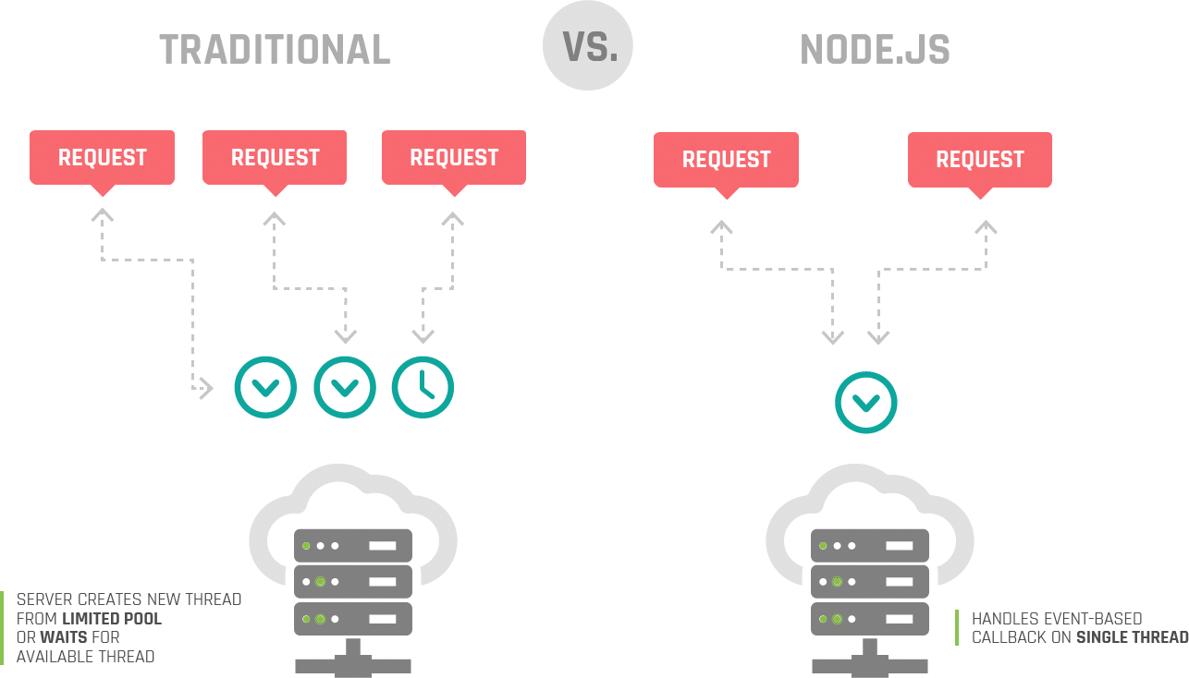

Slide 18
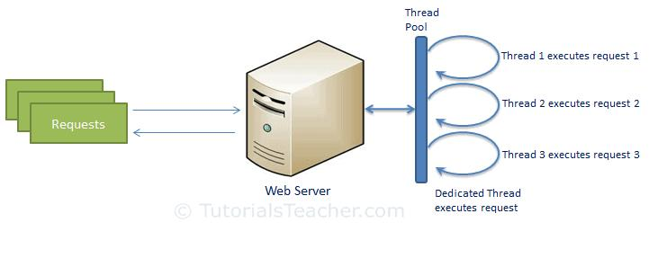

Slide 19
Node.js Process Model :
The Node.js Process Model is designed to efficiently handle a large number of concurrent requests with minimal system resource consumption. It uses a single-threaded, event-driven, non-blocking I/O model to achieve scalability and high performance.
Node.js processes user requests differently when compared to a traditional web server model.
Node.js runs in a single process and the application code runs in a single thread and thereby needs less resources than other platforms.
All the user requests to your web application will be handled by a single thread and all the I/O work or long running job is performed asynchronously for a particular request.
So, this single thread doesn't have to wait for the request to complete and is free to handle the next request. When asynchronous I/O work completes then it processes the request further and sends the response.

Slide 20
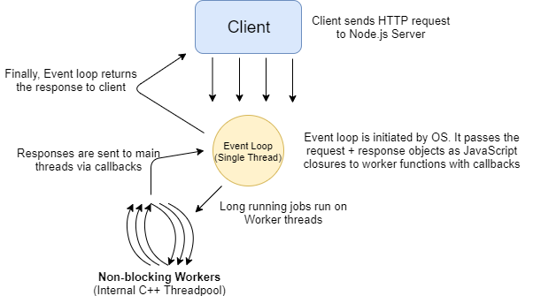

Slide 21
Traditional Process Model | Node.js Process Model
Thread/Process per request | Single-threaded with an event loop
Blocking I/O | Non-blocking, asynchronous I/O
Resource-intensive | Lightweight and memory-efficient
Limited concurrency | Handles thousands of connections

Slide 22
Asynchronous programming with Node.js:
Asynchronous programming in Node.js is a programming paradigm that allows tasks to be executed without blocking the main thread. Instead of waiting for a task (like I/O operations) to complete, Node.js delegates(assigns the responsibility of performing a task to OS) it to the operating system and continues executing other tasks. When the delegated task completes, a callback or event notifies Node.js to resume the operation.
Key Concepts of Asynchronous Programming:
Non-Blocking I/O
Callbacks
Promises
Async/Await

Slide 23
1. Non-Blocking I/O:
Node.js performs I/O operations (like reading files, network requests, or database queries) asynchronously.
Instead of waiting for an I/O task to complete, Node.js offloads it to the operating system or a thread pool.
The main thread remains free to handle new incoming tasks.
2. Callbacks:
A callback is a function passed as an argument to another function , which is then executed after the completion of that function's task.
Callbacks are commonly used for handling the results of asynchronous tasks.

Slide 24
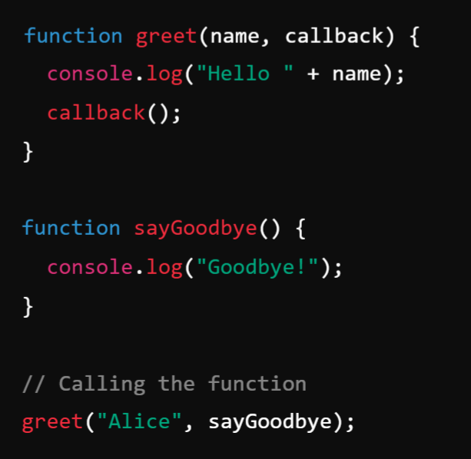

Types of Callbacks
Synchronous Callback: Executed immediately, during the execution of the higher-order function.
Example: Output:

Slide 25
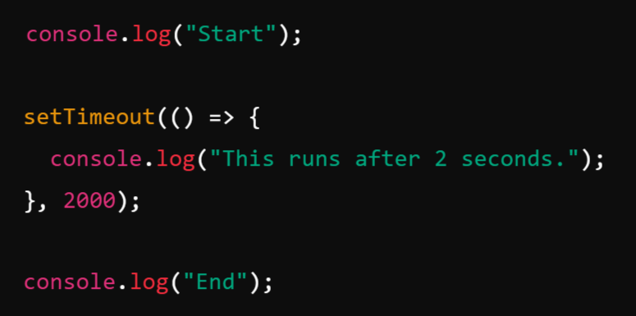
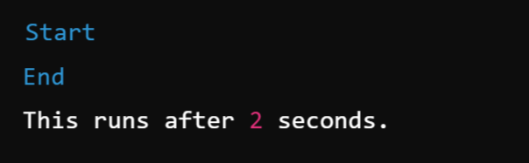
2. Asynchronous Callback: Executed after the completion of an asynchronous operation (e.g., I/O tasks).
Example: Output:

Slide 26
3. Promises:
A Promise is an object that represents the eventual completion (or failure) of an asynchronous task and allows you to handle its outcome.
Promises provide a cleaner and more structured way to write asynchronous code compared to callbacks.
Promises make it easier to manage asynchronous code and avoid "callback hell" by providing a more structured way to handle asynchronous tasks.
States of a Promise:
Pending: The initial state, neither fulfilled nor rejected.
Fulfilled: The operation completed successfully, and the then() callback is executed.
Rejected: The operation failed, and the catch() callback is executed.

Slide 27
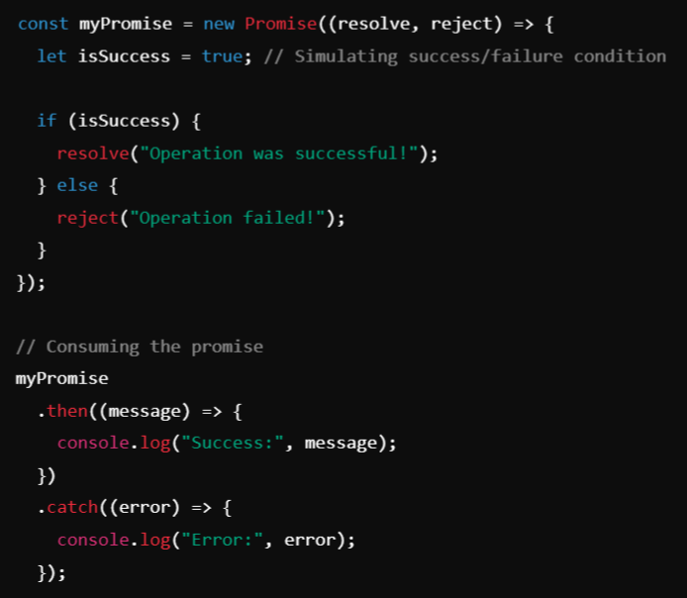
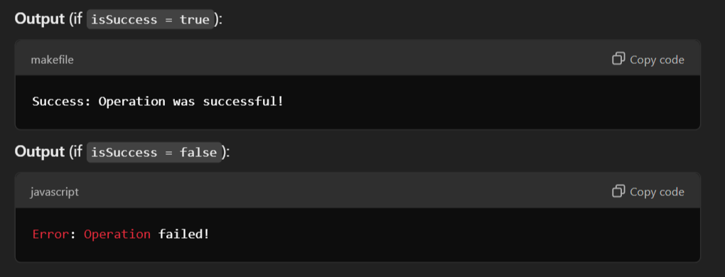
How Promises Work
A promise object takes a function (executor) with two arguments:
resolve: Called when the operation completes successfully.
reject: Called when the operation fails.

Slide 28
4. Async/Await:
Async/Await is a modern syntax introduced in JavaScript to write asynchronous code that looks and behaves like synchronous code.
It makes the code more readable and easier to manage.
How Does It Work?
1. async Function:
Declaring a function with the async keyword makes it return a Promise.
Inside an async function, you can use await to pause execution until a Promise is resolved or rejected.
2. await Keyword:
Can only be used inside an async function.
Pauses the execution of the async function and waits for the Promise to resolve, then resumes with the resolved value.

Slide 29
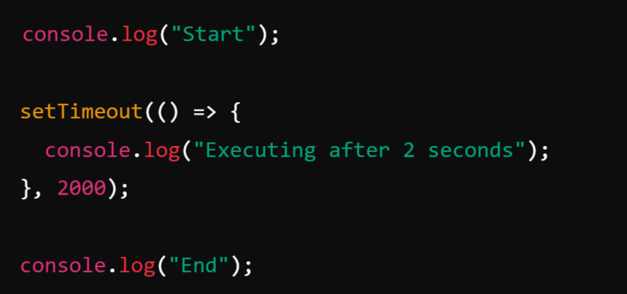
Example for Asynchronous programming:

Slide 30
Types of applications that can be developed using Node.js:
Node.js is widely used for building various types of applications due to its non-blocking I/O model, event-driven architecture, and high scalability.
Real-Time Applications
API Servers and Backend Systems
Web-Applications
Streaming Applications
Single Page Applications (SPAs)
Command-Line Tools
IoT Applications

Slide 31
1. Real-Time Applications
Node.js is ideal for building real-time applications (RTAs) like chat apps, online gaming, or live notifications.
The event-driven architecture and support for WebSockets (Protocol) which make it perfect for handling real-time, bi-directional communication.
Examples:
Chat applications (e.g., WhatsApp clones)
Collaborative tools (Google Docs-like editors)
Live notifications systems

Slide 32
2. API Servers and Backend Systems
Node.js is extensively used to build RESTful APIs and GraphQL APIs that handle HTTP requests and responses efficiently.
With libraries like Express.js, it’s easy to create lightweight, fast, and scalable APIs.
Examples:
Backend for mobile or web applications
Payment gateways
Microservices architecture
3. Web-Applications:
Node.js is commonly used for building web applications, thanks to its ability to handle a large number of concurrent connections efficiently. For example, LinkedIn uses Node.js for its mobile backend.

Slide 33
4. Streaming Applications
Node.js provides support for data streaming, allowing developers to process files or data chunks while they are being uploaded or downloaded.
It’s perfect for building streaming services similar to YouTube or Netflix.
Examples:
Media streaming platforms (YouTube)
Audio/Video broadcasting
Real-time file uploads or downloads
5. Single Page Applications (SPAs)
Node.js, when combined with frontend frameworks like React, Vue, or Angular, is ideal for developing SPAs.
SPAs load a single HTML page and dynamically update content without refreshing the page.

Slide 34
6. Command-Line Tools:
Developers can build custom CLI (Command-Line Interface) tools using Node.js.
Libraries like Commander.js and Yargs simplify the development of CLI tools.
Examples:
Automation scripts
Package managers like npm
Custom utility tools for developers
7. IoT Applications
Node.js is lightweight and can run efficiently on IoT devices.
It enables real-time communication and data exchange between IoT sensors, servers, and user interfaces.

Slide 35
Installing Node.js on Windows:
Download Node.js: Visit the official Node.js website ( https://nodejs.org.) and download the Windows installer.
Run the Installer: Double-click the downloaded installer to run it. Follow the on-screen instructions in the installation wizard.
Verify Installation: After the installation is complete, open a command prompt and type node –v or node --version. This command should print the installed version of Node.js. Similarly, you can check the version of npm (Node Package Manager) by typing npm -v.

Slide 36
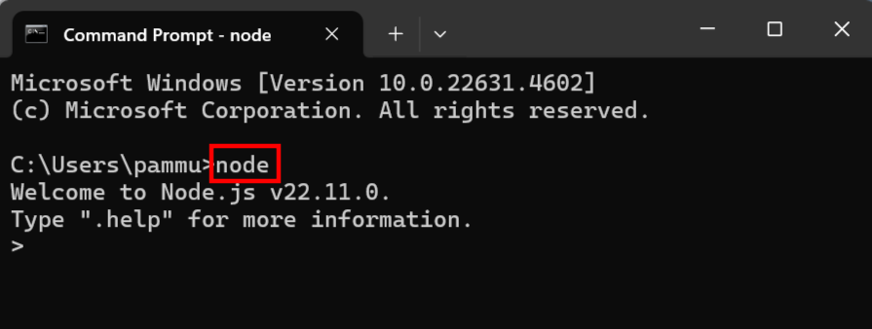
Working in REPL (Read-Eval-Print Loop):
It is an Interactive shell provided by Node.js, where you can write, evaluate, and test JavaScript/Node.js code in real-time.
Start REPL: Open a command prompt and type node to start the Node.js REPL.
Use the REPL: You can now enter JavaScript code directly into the REPL. Press Enter to execute the code. For example: > console.log("Hello, Node.js!");
Exit REPL: To exit the REPL, press Ctrl + C twice or type .exit.

Slide 37
Basic Commands in REPL:
S.No | Operations | Example
1 | Mathematical Operations | 5 + 3, 5/10
2 | Variable Declaration | let a = 20, const b = 30
3 | Functions: | function greet(name){ ... return `Hello ${name}` ... } greet(“Pramod”)
4 | Multi-line Input: | Use { to start a block and } to end it if (true) { ... console.log("This is inside the block"); ... }
5 | Use _ to Get the Last Result: | _
6 | Access Node.js Features: | const os = require('os') os.platform()
7 | Exit REPL | Press Ctrl + c twice or type .exit

Slide 38
Node.js Console:
The Node.js Console module provides a simple debugging console that is similar to the console in web browsers. It is used to print messages, debug logs, or error information to the standard output (stdout) or standard error (stderr).
The console module is available globally, so it does not require importing unless advanced features are needed.

Slide 39
Important Methods of Console Module:
Method | Description
console.log() | Outputs general information to stdout.
console.error() | Outputs error messages to stderr.
console.warn() | Outputs warnings to stderr.
console.info() | Similar to console.log().
console.trace() | Prints a stack trace of the point at which it is called.
console.time() | Starts a timer for measuring code execution time.
console.timeEnd() | Ends a timer and logs the elapsed time.
console.table() | Displays tabular data in table format.
console.assert() | Logs a message if the assertion is false.
console.clear() | Clears the console (works in some environments).

Slide 40
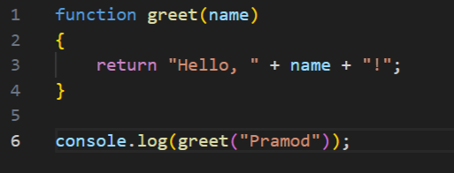
Creating a Node File with JavaScript:
Create a Node.js File: Create a new file with .js extension and open it in a text editor.
Write JavaScript Code: Write your JavaScript code in the file.
For example:
Run the Node.js File: Save the file and run it from the command line using node command node filename.js. You should see the greeting message printed to the console.

Slide 41
Accessing a Node.js File Through the Command Line Interface:
Navigate to File Directory: Open a command prompt and navigate to the directory containing your Node.js file.
Run the File: Run the Node.js file using node <filename>.js, replacing with the name of your file.

Slide 42
Using Node.js in Net- Beans IDE:
Install NetBeans IDE: Download and install the latest version of NetBeans IDE from the official website (https://netbeans.apache.org/ ).
Install Node.js Plugin: Open NetBeans IDE and go to Tools > Plugins. Search for "Node.js" in the Available Plugins tab and install the Node.js plugin.
Create a Node.js Project: Go to File > New Project. Select "Node.js" from the list of project types and click Next. Follow the wizard to create a new Node.js project.
Write and Run Code: Write your Node.js code in the IDE. Use the built-in features for editing, debugging, and running Node.js applications.

Slide 43
How to create a Nodejs project?
To create a NodeJS project, please follow the below steps:
Select File Menu + Select New Project ( or use shortcut command Ctrl + Shift + N)
It Opens the New Project window dialog, Select the following
On the Left side, Select HTML5/Javascript in Categories, Right side, Select Nodejs Application.
Next, Enter the following
Project Name: Any Name of You’re Choice.
Project Folder: newly created project location to save
Next step, It asks for the following things
Create package.json
Create bower.json
Create gulpfile.js
Create gruntfile.js
Click Finish, It creates a Nodejs application
It loads the newly created app in Netbeans.
Now, you are ready to work on the Nodejs application
https://www.w3schools.io/editor/netbeans-nodejs-app/

Slide 44
What is the Event Loop?
The Event Loop is a fundamental concept in JavaScript and Node.js that enables non-blocking and asynchronous programming. It allows JavaScript to handle multiple tasks, such as I/O operations, without blocking the main thread.
JavaScript operates on a single-threaded model, meaning it can only execute one piece of code at a time. The event loop orchestrates the execution of code, handles events, and performs asynchronous operations.

Slide 45
https://www.youtube.com/watch?v=8aGhZQkoFbQ

Slide 46
Components in the Diagram:
Heap:
Memory storage where objects and data are allocated.
Long-lived data resides here, e.g., objects and variables.
Stack (Call Stack):
The stack is a data structure where function calls are placed and executed.
Functions are pushed when called and popped when completed.
Web APIs:
Browser-provided APIs or Node.js equivalents (e.g., setTimeout, XMLHttpRequest).
Used for handling asynchronous tasks (like timers, HTTP requests, or DOM events).
Callback Queue (Task Queue):
A queue where asynchronous callbacks are pushed after the Web APIs finish their task.
Tasks in the callback queue are moved to the Call Stack when the stack is empty.
Event Loop:
A mechanism that continuously monitors the Call Stack and Callback Queue.
If the stack is empty, the Event Loop pushes tasks from the Callback Queue into the stack.

Slide 47
How the Event Loop Works:
Call Stack:
The Call Stack is a data structure used in JavaScript and other programming languages to manage the execution of functions. It operates on the principle of Last In, First Out (LIFO), meaning the most recently added (or called) function is executed first, and once it's finished, it's removed from the stack.
The Call Stack keeps track of:
The currently executing function.
Functions that are waiting to execute.
So,
Call Stack Keeps track of the code currently being executed.
Functions are pushed to the stack when called and popped off when execution is complete.

Slide 48
How the Call Stack Works:
Function Calls: When a function is called, it is pushed onto the stack.
Execution: The function at the top of the stack is executed.
Completion: When the function execution is complete, it is popped off the stack.
Error: If the stack becomes too large (e.g., due to infinite recursion), it causes a Stack Overflow. When the stack exceeds its allocated size, the JavaScript engine throws a RangeError (e.g., Maximum call stack size exceeded).

Slide 49
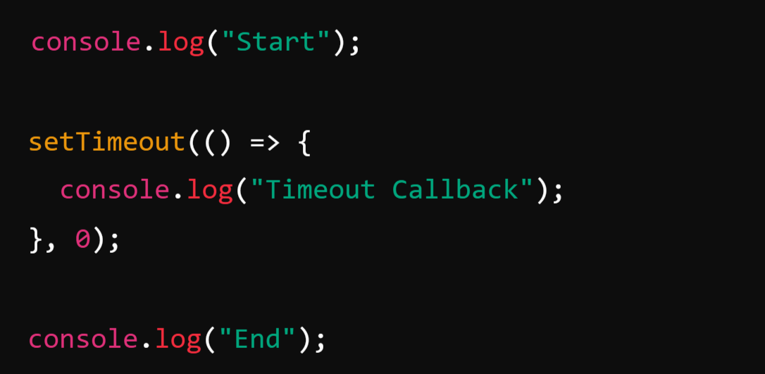
Call Stack in the Context of Asynchronous Code: Web APIs and Callback Queue
The Call Stack is only responsible for synchronous function execution. Asynchronous tasks (like setTimeout, Promises, or I/O operations) are handled by the event loop and do not block the Call Stack.
Example:
Execution:
1. console.log("Start") runs first:
Output: "Start“
2. setTimeout is registered with the event loop, and its callback is sent to the callback queue.
3. console.log("End") runs:
Output: "End"
4. Once the Call Stack is empty, the callback from setTimeout is executed:
Output: "Timeout Callback"

Slide 50
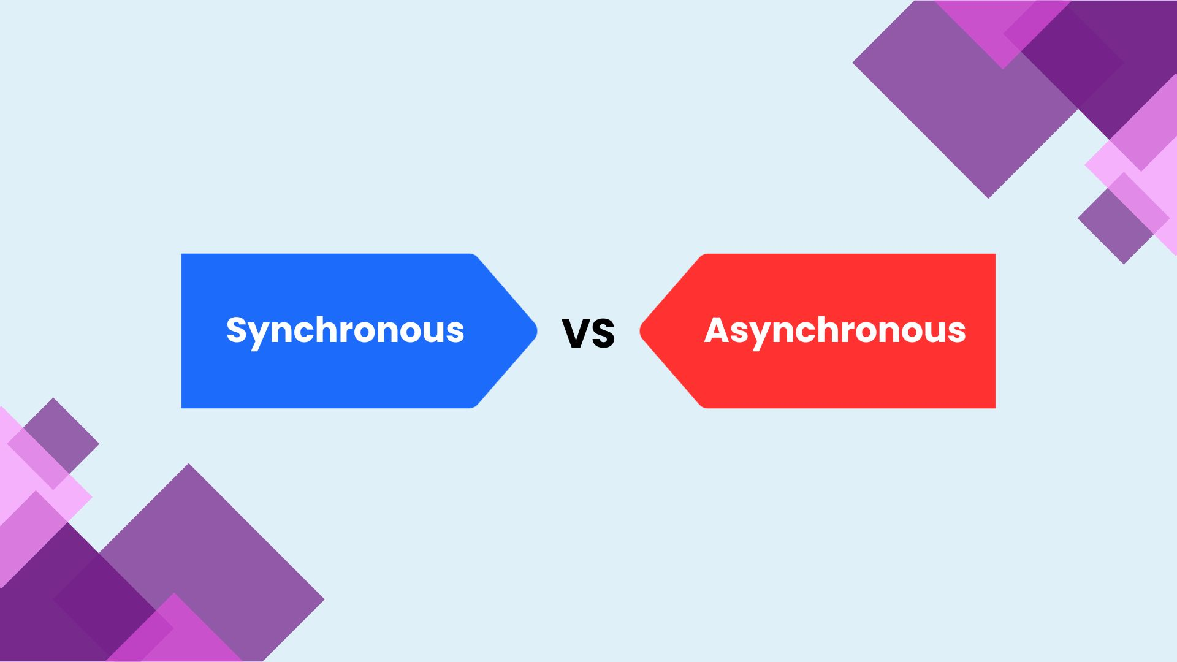

Slide 51
What is Synchronous Code?
Definition: Code that executes sequentially, line by line, and blocks further execution until the current task is complete.
Characteristics:
Each operation waits for the previous one to finish before starting.
If a task is time-consuming, it blocks the program's execution.
Typically used for simple, predictable operations.
Examples:
Regular function calls.
Loops like for, while, etc.
Variable assignments and mathematical operations.
File system operations in Node.js using synchronous methods (fs.readFileSync()).
How to Identify:
Check if the function runs and completes immediately without relying on external events or timers.

Slide 52
What is Asynchronous Code?
Definition: Code that allows the program to continue executing other tasks while waiting for an operation to complete in the background.
Characteristics:
Non-blocking: Other tasks are executed while the asynchronous operation runs.
Involves callbacks, promises, or async/await.
Often used for tasks involving external systems (e.g., servers, databases, file I/O, or timers).
Examples of Asynchronous Code:
setTimeout, setInterval (timers).
File system operations with callbacks (fs.readFile() in Node.js).
Fetching data from APIs (fetch(), axios).
DOM event listeners (addEventListener).

Slide 53
How to Identify Asynchronous Code :
If the function involves:
External I/O (e.g., network requests, file operations).
Timer delays.
A return value of a promise or a callback.

Slide 54
Answer the following: 7 Marks
1. Explain the features of Node.js that make it suitable for building scalable web
applications.
2. Compare the traditional web server model with the Node.js process model.
3. Give the advantages of the Node.js model.
4. Discuss the concept of asynchronous programming in Node.js and list its advantages
5. Describe the steps to install Node.js on a Windows system. Include the process of
setting up the development environment and running a simple Node.js file.
6. Explain the role of the Node.js Console in development. How can developers use it to
debug and interact with Node.js applications?
7. Explain how the event loop works in Node.js and its significance in building scalable
applications.
8. Provide a step-by-step explanation of the event loop's processing of asynchronous tasks.

Slide 55
10 marks:
9. How does Node.js leverage non-blocking, event-driven architecture to handle
concurrent requests efficiently? Provide a detailed explanation with examples.
10. Describe the Node.js module system. How does it help in organizing and managing code in Node.js applications? Provide examples to demonstrate module creation, import, and export in Node.js.

Slide 56
UNIT-I:
Introduction: Features and advantages of Node JS, Traditional Web Server Model, Node.js Process Model, Asynchronous programming with Node.js, Types of applications that can be developed using Node.js.
Setup Development Environment: Install Node.js on Windows, working in REPL, Node JS Console, Creating a Node File with JavaScript, Accessing a Node.js File Through the Command Line Interface, Using Node.js in Net- Beans IDE.

Slide 57
UNIT-I: Introduction

Slide 59
